Slide 1
FBG10N30BSH Reliability Data
5/1/24

Slide 2
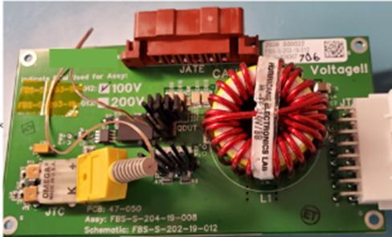
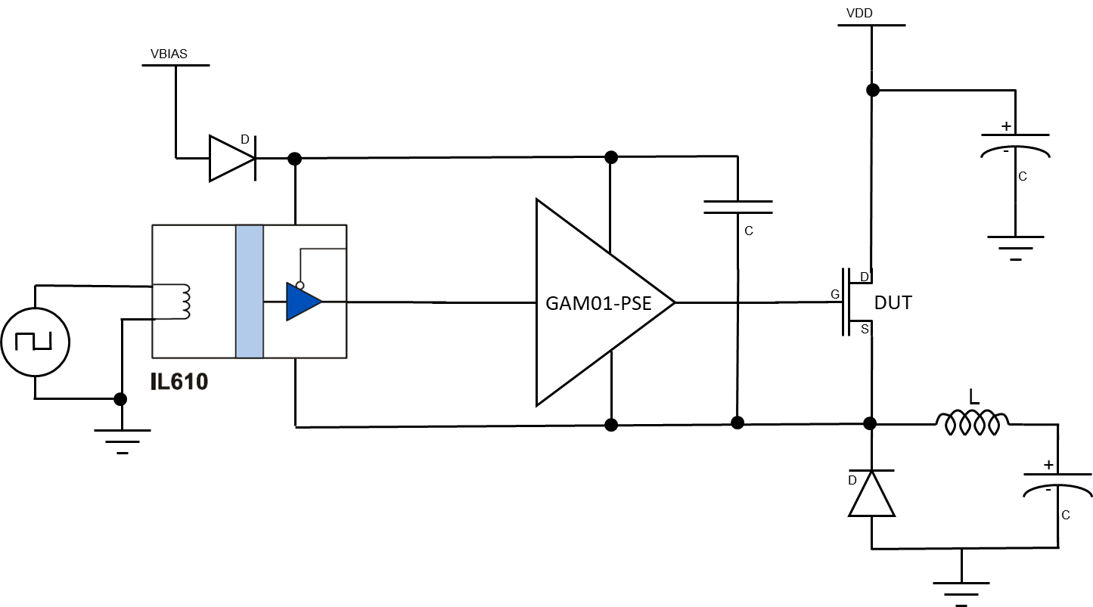
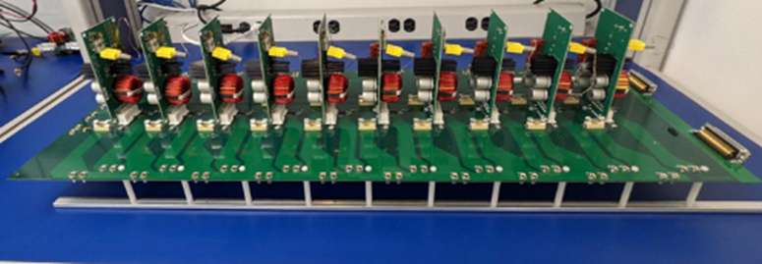
FBG10N30BSH Circuit
The circuit was not optimized for efficiency but rather to demonstrate the stability of device and Rdson.
GAM01 Driver
FBG20N18
FBG20N18
Or
FBG10N30
Simplified High Side Buck converter circuit

Slide 3
FBG10N30BSH Switching Life Test
Tested variations of VDS voltage, IDS current and Switching Frequency in a high side buck converter over a 2000+ hours time and across 3 wafer lots.
VDS tested : 60V and 90V ( 10% over 80% VDS requirement) measured at Power supply and does not include any overshoot occurring at the DUT due to the buck circuit performance.
Iout tested : 1A, 4.5A
Parts tested with full parametric test at interim steps 48,hrs, 120hrs, 260hrs, 500hrs, 1000hrs, 2000hrs, 3000hrs.
No failures have been observed.

Slide 4
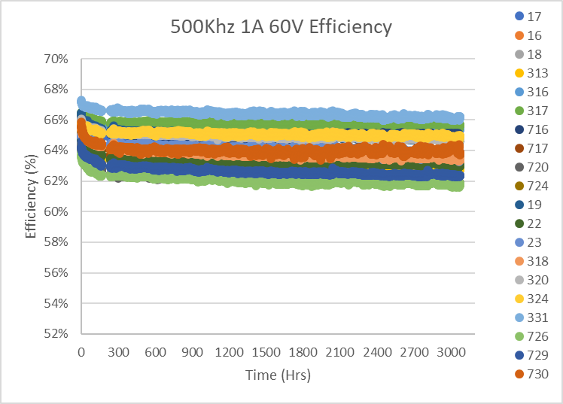
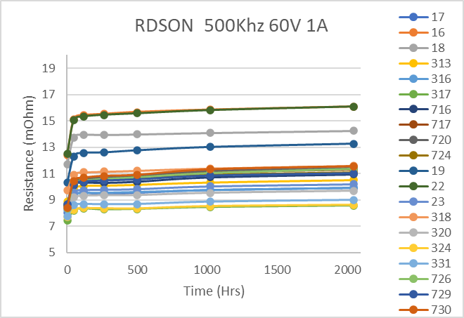
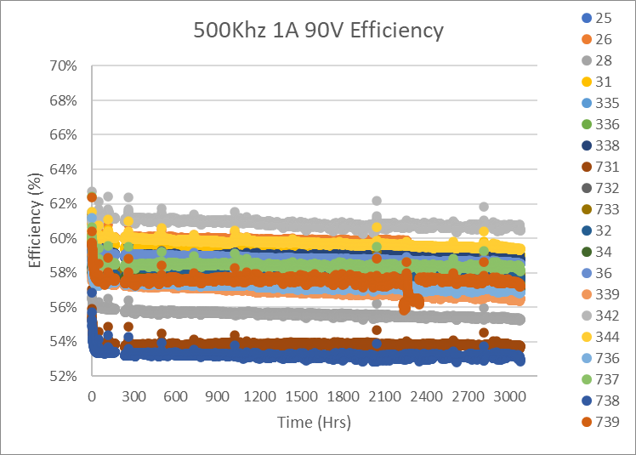
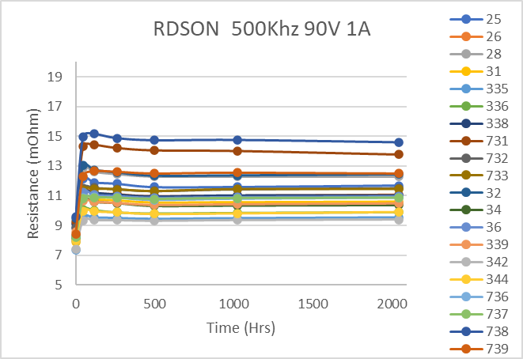
EFFICIENCY at 500kHz VDS=60V -90V Io=1A

Slide 5
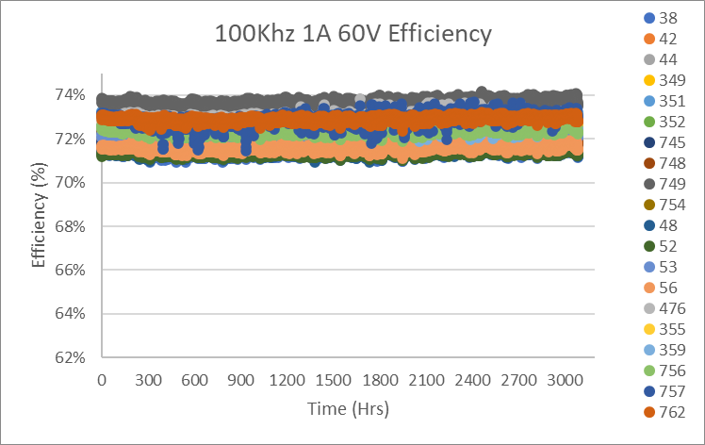
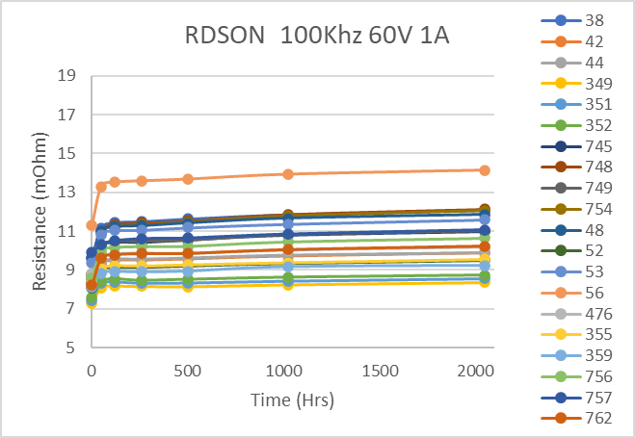
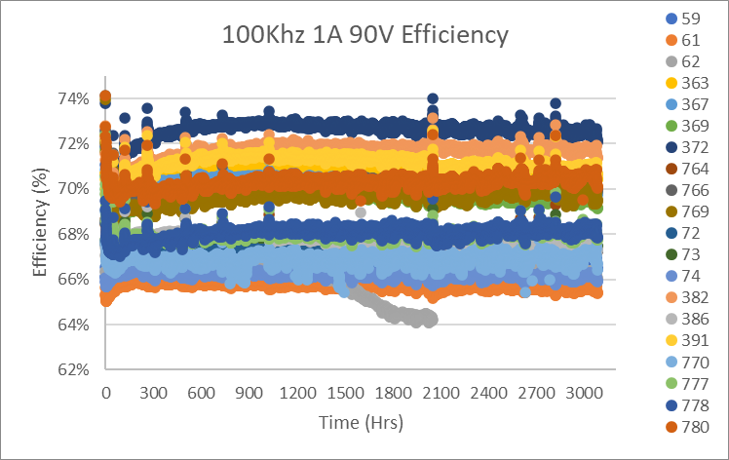
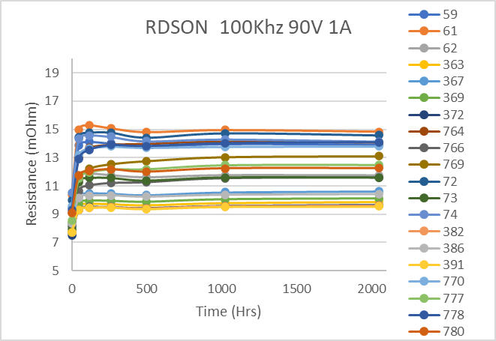
EFFICIENCY at 100kHz VDS=60V -90V Io=1A

Slide 6
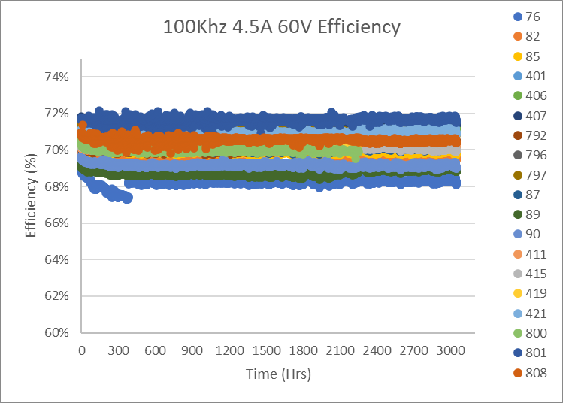
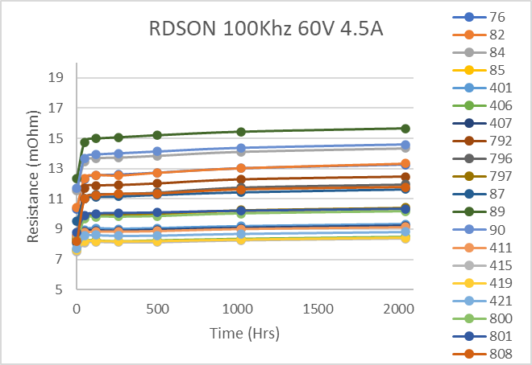
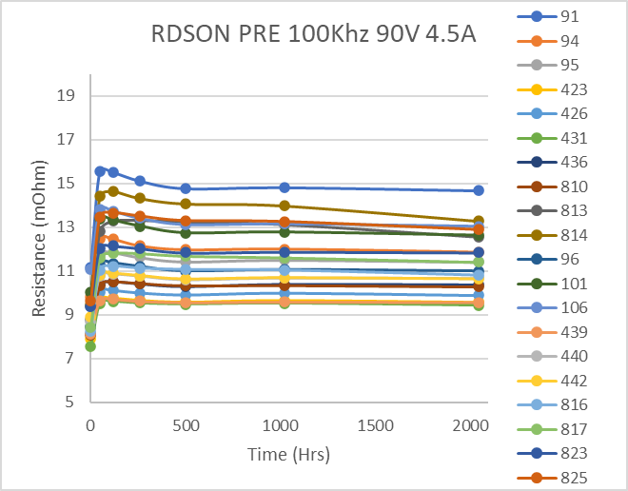
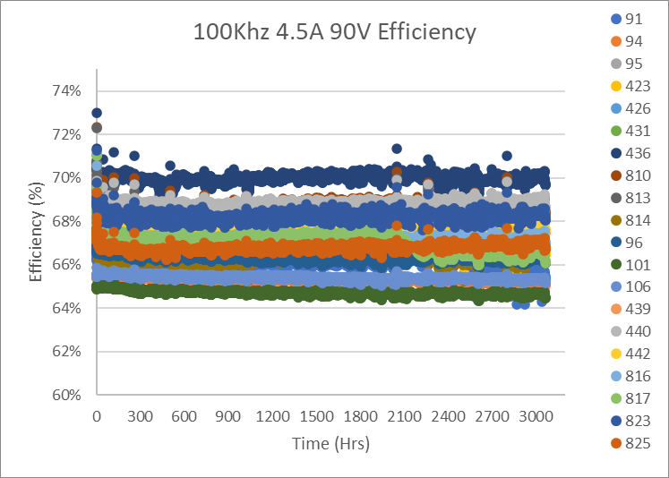
EFFICIENCY at 100kHz VDS=60V -90V Io=4.5A

Slide 7
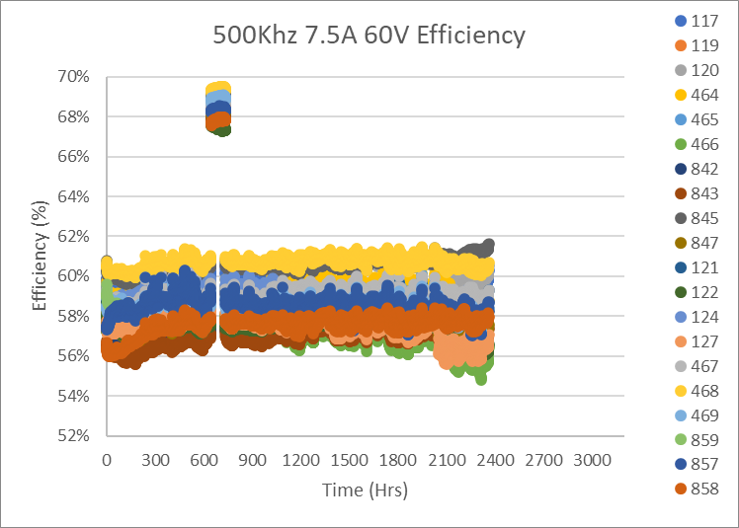
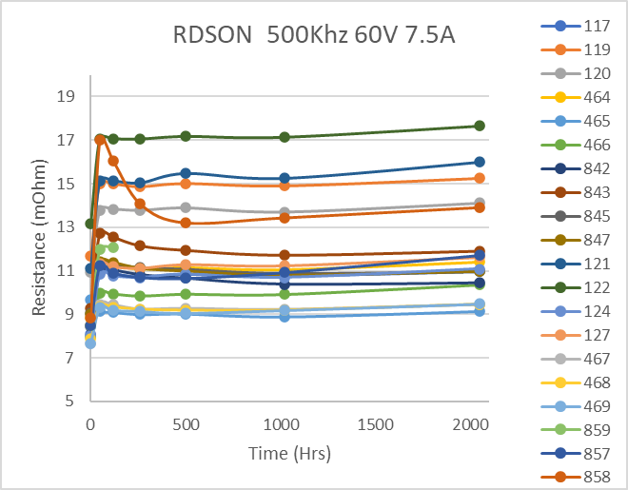
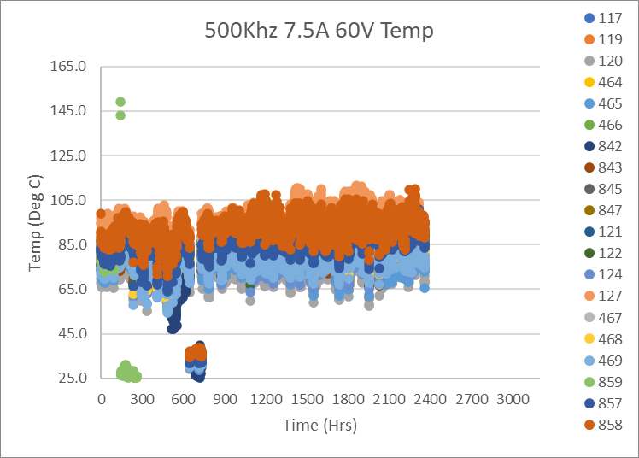
EFFICIENCY at 500kHz VDS=60V Io=7.5A
Lab window left open over the weekend, and it was snowing in Massachusetts.

Slide 8
FBG10N30BSH DC LIFE TEST
Tested variations of VDS and VGS voltages over several temperatures over a 2000Hrs timeframe
VDS Tested : 110V, 120V, 130V at Temperatures of 120C
VGS Tested : 5V, 6V, 6.75V at Temperatures of 110C and 150C
Parts tested with full parametric test at interim steps 24hrs, 48,hrs, 96hrs, 210hrs, 500hrs, 1000hrs, 1500hrs, 2000hrs
Parts with very high leakage were removed at each step
X axis (voltage represents Applied stress voltage not test voltage)

Slide 9
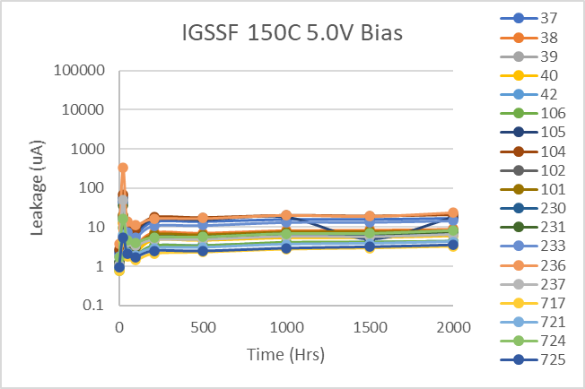
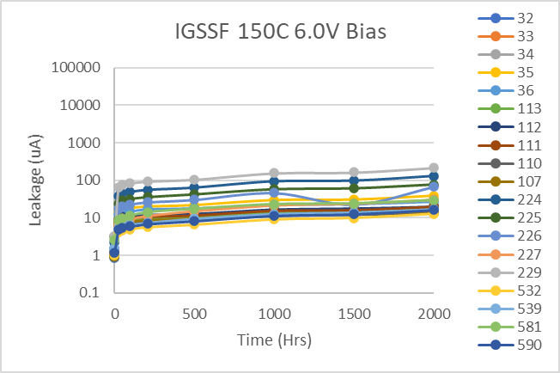
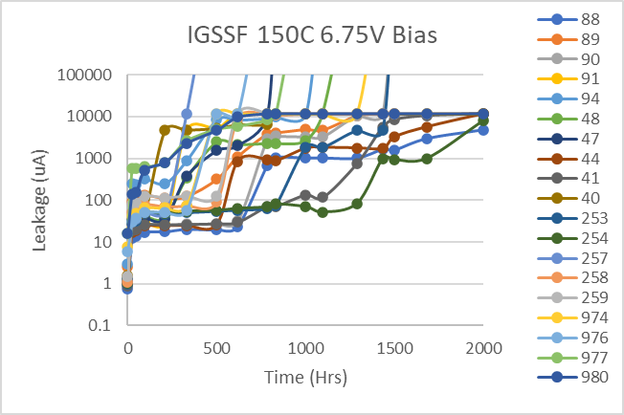
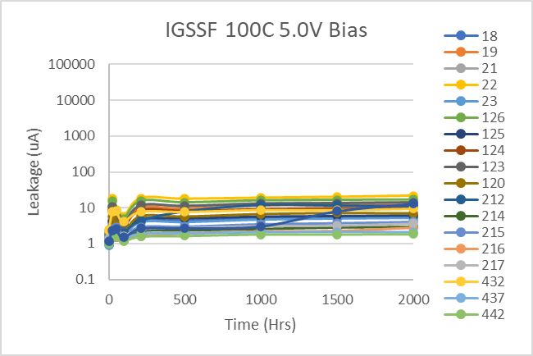
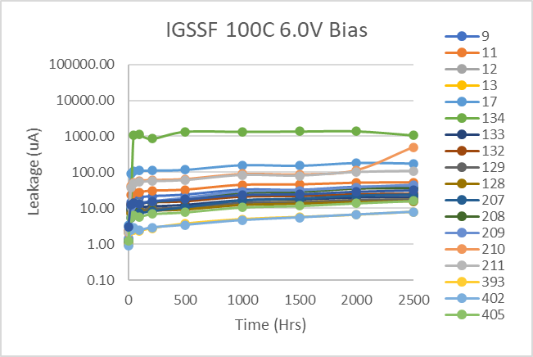
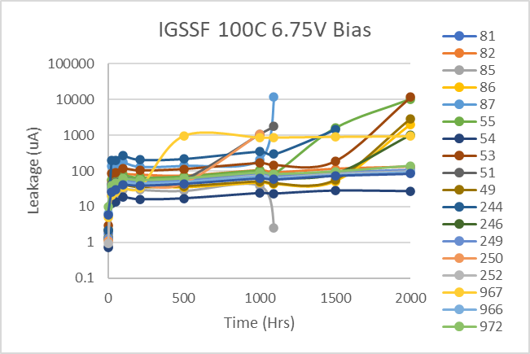
FBG10N30 HTGB LIFE
9

Slide 10
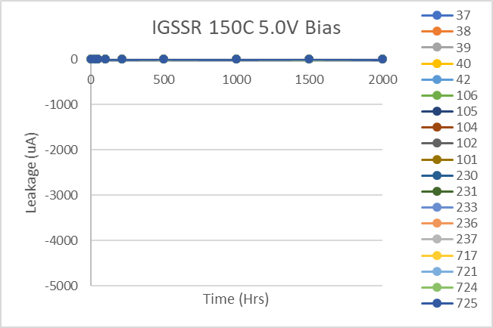
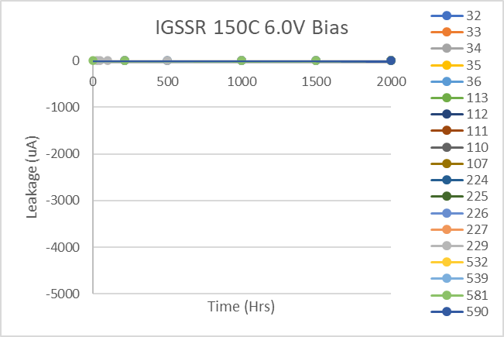
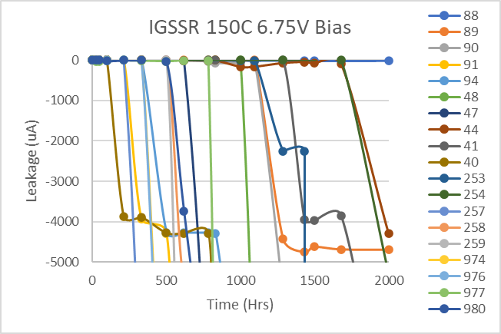
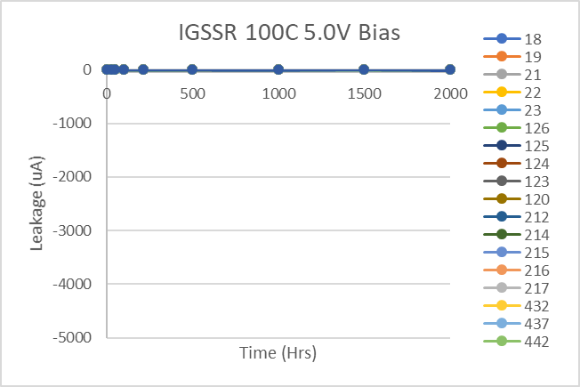
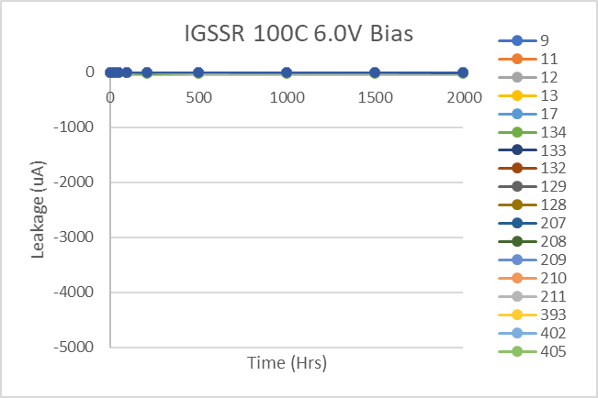
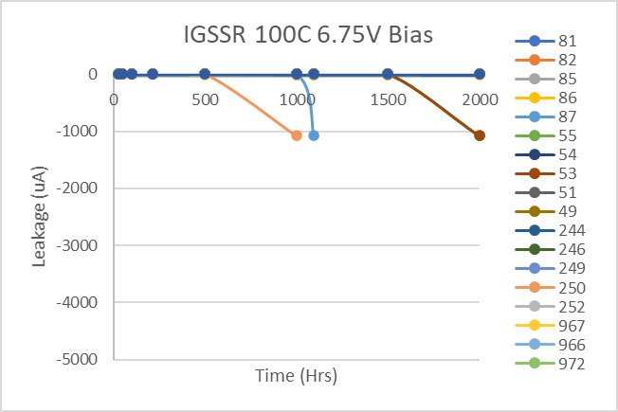
FBG10N30 HTGB LIFE
10

Slide 11
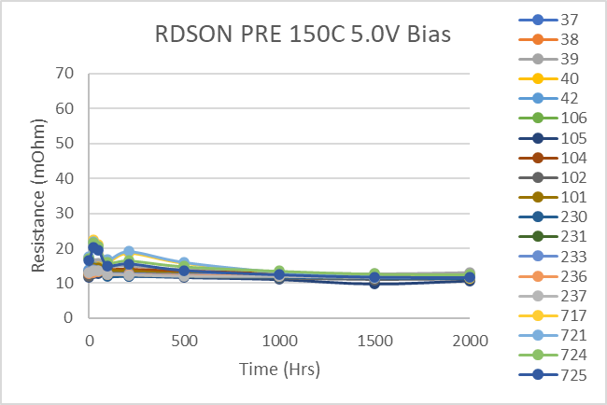
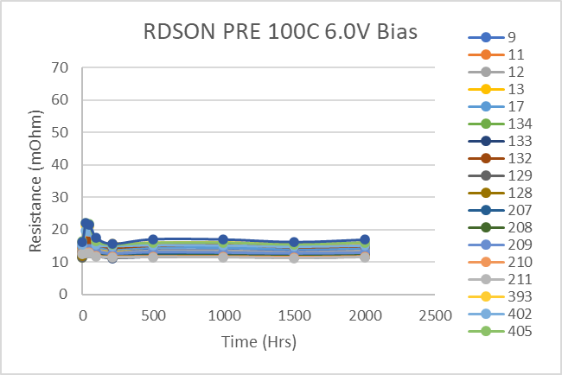
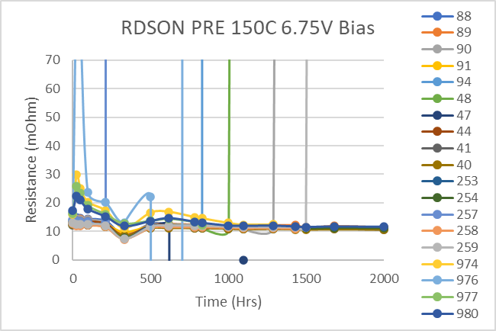
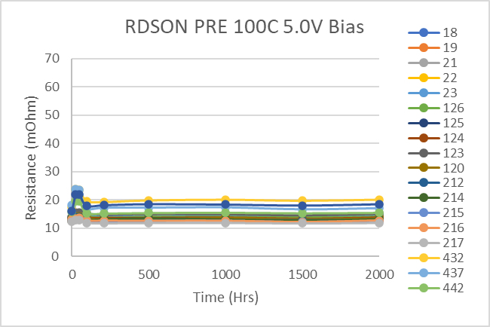
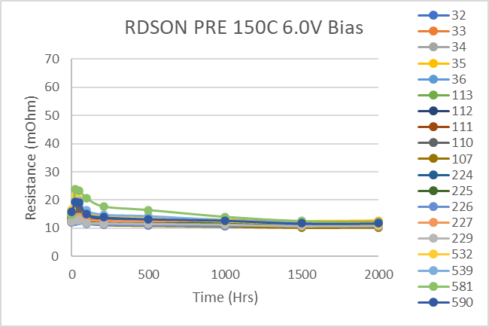
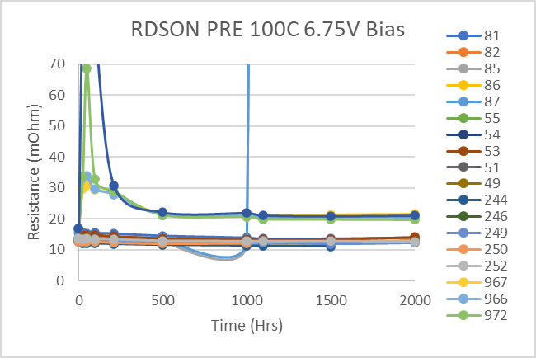
FBG10N30 HTGB LIFE
11

Slide 12
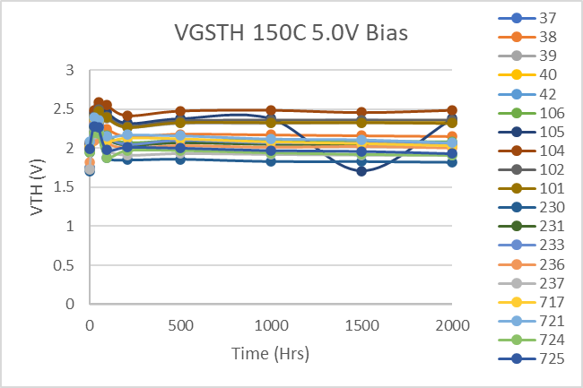
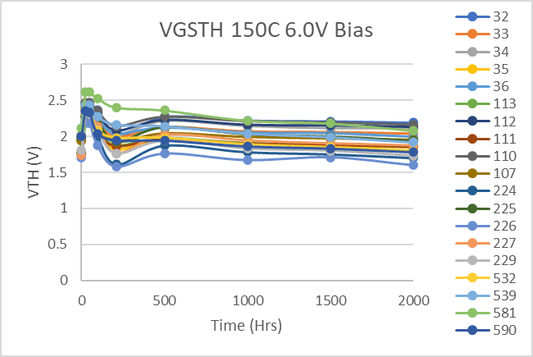
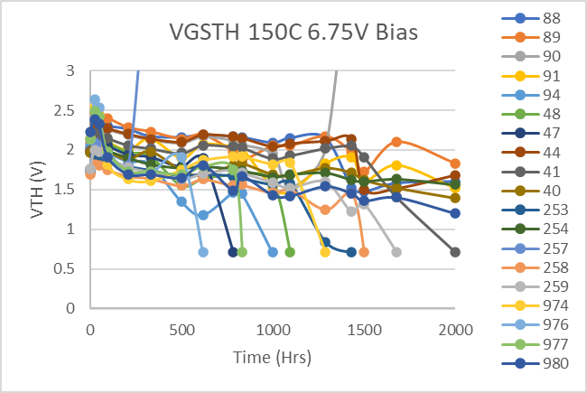
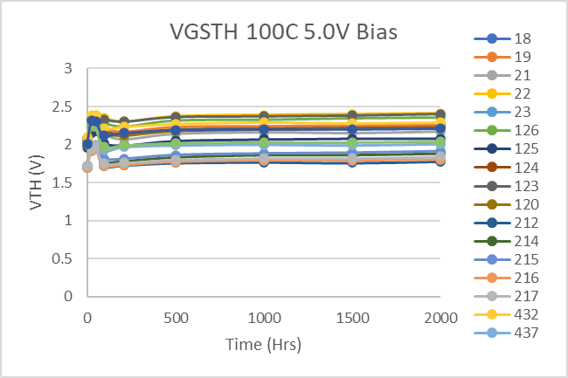
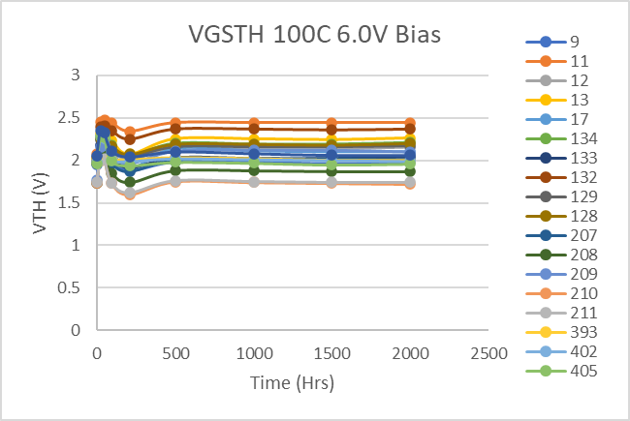
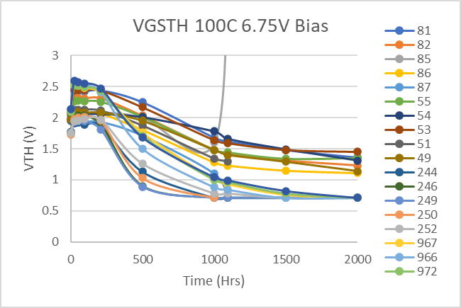
FBG10N30 HTGB LIFE
12

Slide 13
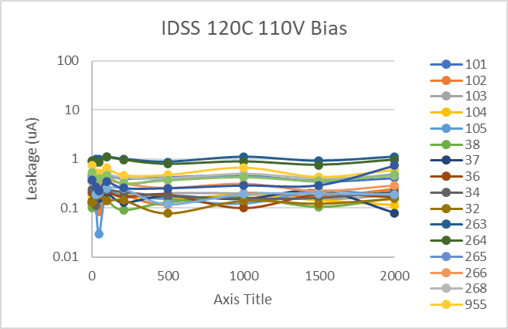
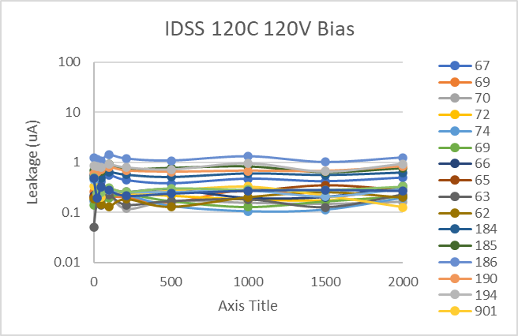
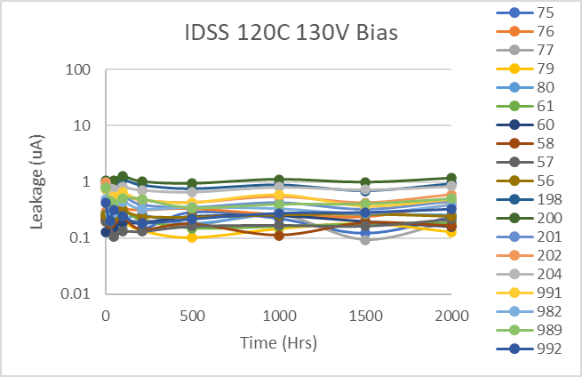
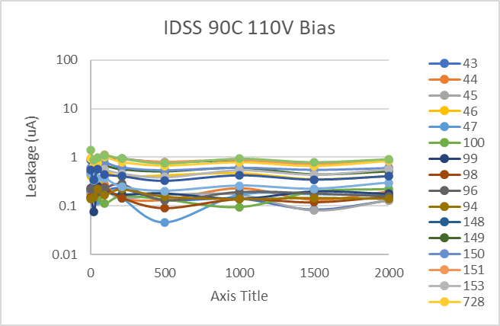
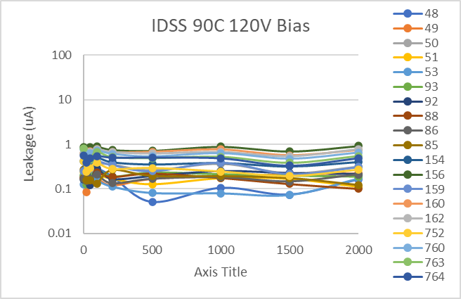
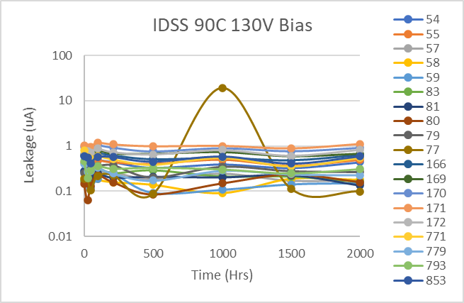
FBG10N30 HTRB LIFE
13

Slide 14
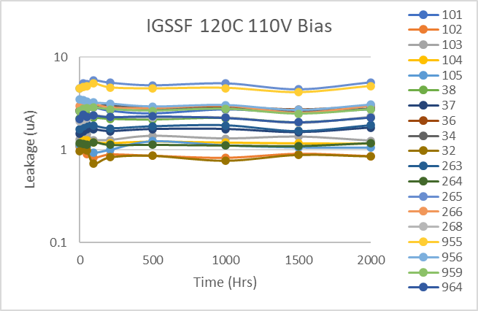
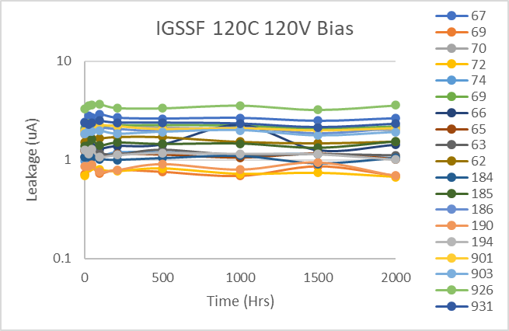




FBG10N30 HTRB LIFE
14

Slide 15






FBG10N30 HTRB LIFE
15

Slide 16






FBG10N30 HTRB LIFE
16

Slide 17






FBG10N30 HTRB LIFE
17

